Slide 1


SQL Project
Library Database Analysis
Presented by
B.Srilakshmi
Batch No:392

Slide 2
Index
About me
Objective of this project
Problem Statement
ER Diagram
Tables
Key relationships
Key Questions
Final Insights
Conclusion
Challenges & learnings

Slide 3
About me
My Background ? 🎓
I hold a Master of Science (M.Sc.) degree with a strong foundation in analytical thinking, research, and problem-solving.My academic journey has helped me develop a deep interest in data, patterns, and evidence-based decision making.
Why i want to learn Data Analyst?
In today’s data-driven world, I believe data science is a powerful field that can turn raw data into meaningful insights.I am fascinated by how data can help solve real-world problems across domains like healthcare, finance, and technology.With my strong academic background and eagerness to learn, I want to build a career where I can use data to drive smart decisions and innovation.
My Work Experience
I am a fresher and currently do not have industry experience, but I have worked on projects and self-learning assignments focused on data cleaning, exploration, and visualization using tools like Python, Pandas, and Jupyter Notebooks.
My linkedin url: Linkedin
github profile url:- GitHub

Slide 4
Objective of the Project
• Design and query a Library Management System because In many libraries, work is still done manually writing records, tracking books, and calculating fines by hand.
This is slow, can have mistakes, and is hard to manage when the collection grows.
Our system solves these problems using a database.
• Maintain data on books, authors, branches, borrowers, and loans
• Solve real-world queries for library operations.

Slide 5
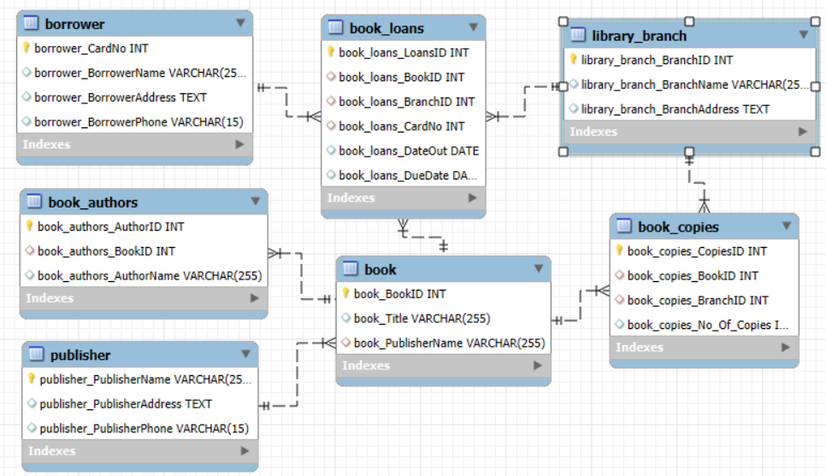
ER Diagram

Slide 6
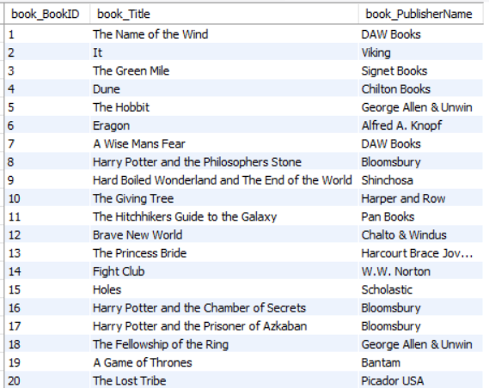
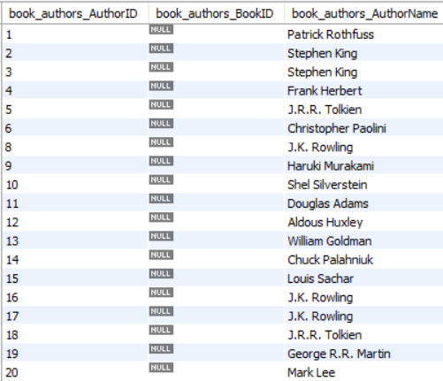
Tables
Book Table
Book Authors Table

Slide 7
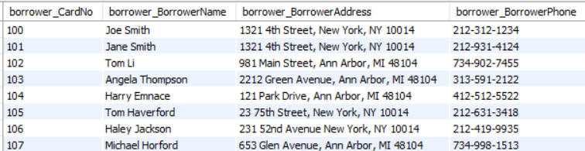
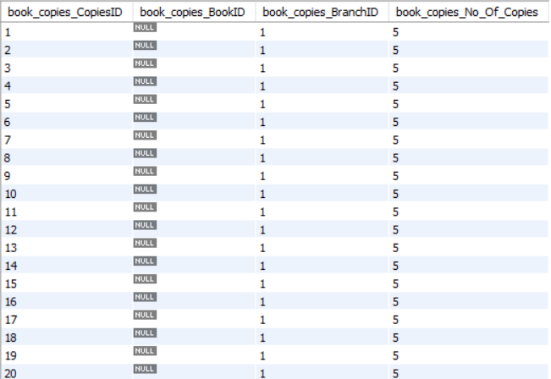
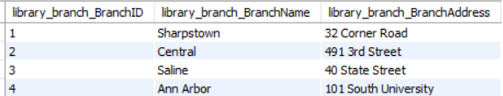
Borrower Table
Book Copies Table
Library Branch Table

Slide 8
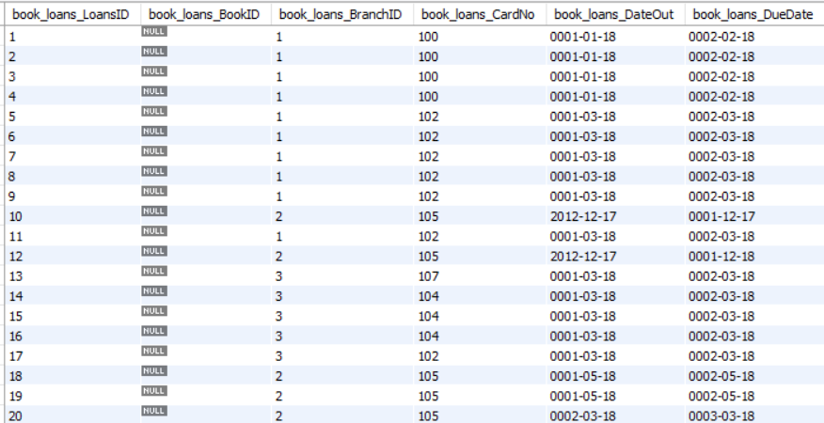
Book Loans Table

Slide 9
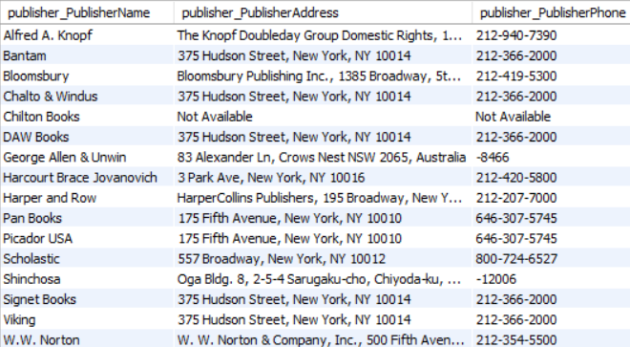
Publisher Table

Slide 10
🔗 Key Relationships:
Publisher ↔ Book → One publisher can publish many books.
Book ↔ Book Authors → One book can have multiple authors.
Book ↔ Book Copies ↔ Library Branch → Tracks how many copies of each book are in each branch.
Book Loans ↔ Borrower → Tracks which borrower borrowed which book.

Slide 11
Problem Statement
The Library Management System is designed to simplify and automate the daily operations of a library by storing and organizing information about books, members, and transactions in a centralized database. It helps librarians easily manage book availability, track borrowing and returns, calculate late fees, and maintain accurate records. By replacing manual processes with a structured digital system, it reduces errors, saves time, improves efficiency, and provides quick access to information for both library staff and members.

Slide 12
Key Questions
1. How many copies of 'The Lost Tribe' in 'Sharpstown' branch?
2. How many copies of 'The Lost Tribe' in each branch?
3. Borrowers with no books checked out
4. Books loaned from 'Sharpstown' with DueDate = '2018-02-03'
5. Books loaned count per branch
6. Borrowers with more than 5 books checked out
7. Books by Stephen King in 'Central' branch

Slide 13
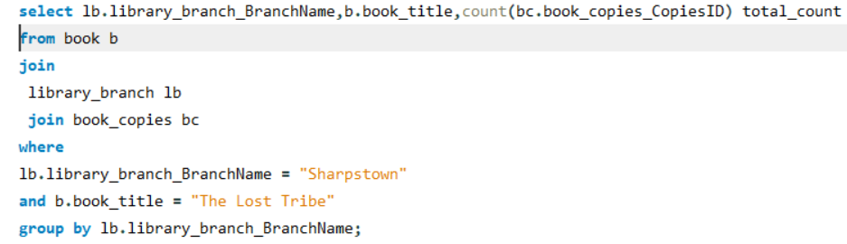

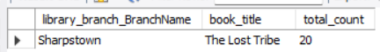
Q1: How many copies of 'The Lost Tribe' in 'Sharpstown' branch?
SQL Query:

Slide 14
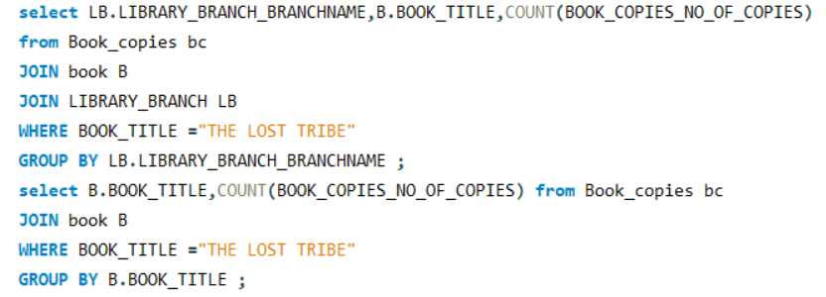

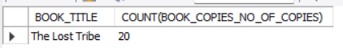
Q2: How many copies of 'The Lost Tribe' in each branch?
SQL Query:

Slide 15
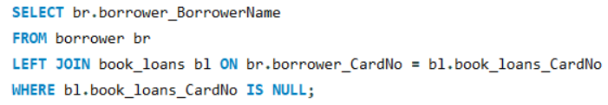

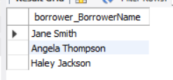
Q3: Borrowers with no books checked out
SQL Query:

Slide 16
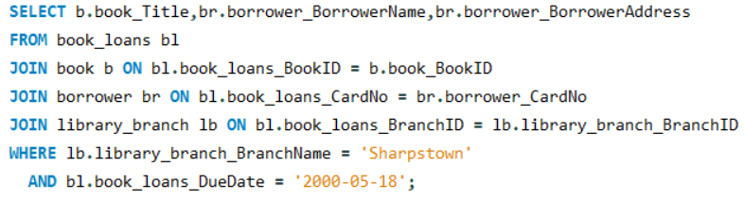

Q4: Books loaned from 'Sharpstown' with DueDate = '2018-02-03'
SQL Query:

Slide 17
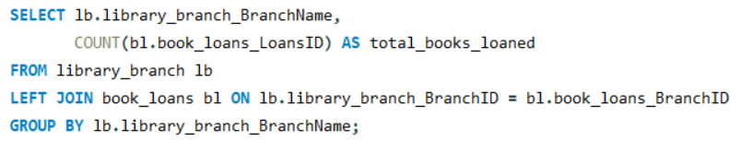
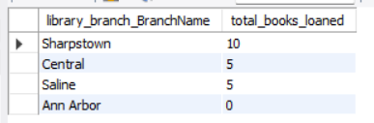

Q5: Books loaned count per branch
SQL Query:

Slide 18
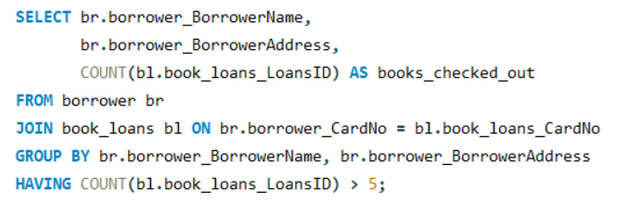

Q6: Borrowers with more than 5 books checked out
SQL Query:

Slide 19
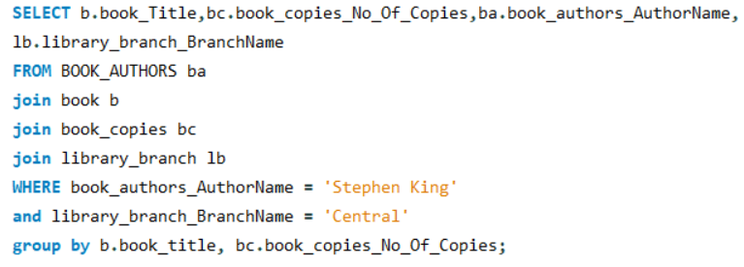
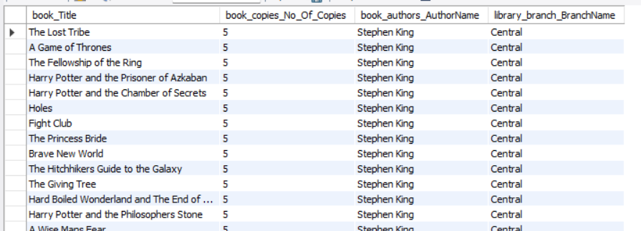

Q7: Books by Stephen King in 'Central' branch
SQL Query:

Slide 20
Final Insights
• Sharpstown branch holds 20 copies of 'The Lost Tribe'
• Tom li borrowers have high activity (more than 5 books)
• Stephen King books are popular in Central branch
• Potential optimization in book distribution among branches

Slide 21
Conclusion
• Successfully implemented library database schema
• Executed advanced SQL queries for practical insights
our Library Management System makes managing books and members much easier.
It saves time, improves accuracy, and gives clear information whenever needed.
• Identified borrower behavior and branch-specific trends

Slide 22
Challenges & Learnings
• Understanding relational mapping in SQL
• Writing optimized joins and subqueries
• Testing queries with realistic sample data
• Insights on database normalization

Slide 23

THANK YOU

